Slide 1
EXTRACTION OF ZINC FROM ZINC ORE
SUMIT KUMAR 2012B1A1650G
UTKARSH TIWARI 2012B3A1424G
HITESH VARMA 2013A1PS637G
JAIPAL RATHORE 2012B3A1706G

Slide 2
Color Legend
Green – Currently employed method or Company
Orange – Outdated method used method or Company
Blue – Extensively used method or ore
Red – Scarcely used method or ore

Slide 3
INTRODUCTION
SUMIT K. YADAV

Slide 4
Zinc concentration
Primarily found in earth’s crust as zinc sulphide (ZnS) .
Ore contains 5-15% zinc .
Needs to be concentrated before smelting .
First crushed then ground for optimal separation from other minerals.
Concentrate contains 55% zinc .
Done at mining site itself to avoid transportation costs to smelters.

Slide 5
Zinc smelting
Process of converting zinc concentrates into pure zinc .
Most common zinc concentrate is ZnS which is obtained from Sphalerite using froth flotation method.
There are two methods of smelting Zinc .
1 . Pyrometallurgical process .
2 . Hydrometallurgical process .
Both these processes have the same first step : Roasting

Slide 6

Roasting
Roasting is the process of oxidizing zinc sulfide concentrates at high temperatures into an impure zinc oxide called “Zinc Calcine”.
The process of roasting varies on the type of roaster used ie. Multiple hearth , suspension or fluidized bed .
The reactions that take place during the process of roasting are as follows .

Slide 7
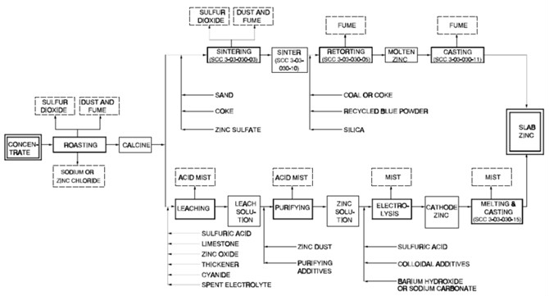
Hydrometallurgical process

Slide 8
The electrolysis process also known as the hydrometallurgical process Roast-Leach-Electrowin (RLE) process or electrolytic process is more widely used than the pyrometallurgical processes .
Consists of 4 steps .
1 . Leaching
2 . Purification
3 . Electrolysis
4 . Melting and Casting

Slide 9
Leaching
The basic reaction that takes place during the process is as follows .

Slide 10
Purification
Utilizes cementation process to further purify the zinc .
Uses zinc dust and steam to remove copper , cadmium , nickel and cobalt .

Slide 11
Electrolysis
Zinc is extracted from the purified ZnS by electrowinning which is a specialized form of electrolysis .
Current is passed through the electrolyte through a series of cells
Industrial process contains several hundred cells .
Two common processes for electrowinning are ;
1 . Low current density process (10% acid + 275A/sq.m )
2 . Tainton high current density process .(22%acid + 1000 A/sq.m )

Slide 12
Pyrometallurgical processes
Several pyrometallurgical processes are used in industries like St. Joseph Minerals Corporation's process, the blast furnace process, the New Jersey Zinc continuous vertical retort process and the Belgian type horizontal retort process .
Major problem is that zinc produced is only 98% pure .

Slide 13
St. Joseph Mineral Company process (outdated)
Developed in 1930 at St. Joseph mineral company .
The advantage of this system is that it is able to smelt a wide variety of zinc bearing materials including electric arc furnace dust.
The disadvantage is that it is less efficient than electrolysis process .

Slide 14
Blast furnace process
The process starts by charging solid sinter and heated coke into the top of the blast furnace .
Preheated air at 190 to 1050 °C is blown into the bottom of the furnace .
Zinc vapour and sulphides leave through the top and enter the condenser .
Slag and lead collect at the bottom of the furnace and are tapped off regularly.
The zinc is scrubbed from the vapour in the condenser via liquid lead.
It is a very energy intensive process and the only countries which still use this process are India , China , Japan and Poland .

Slide 15
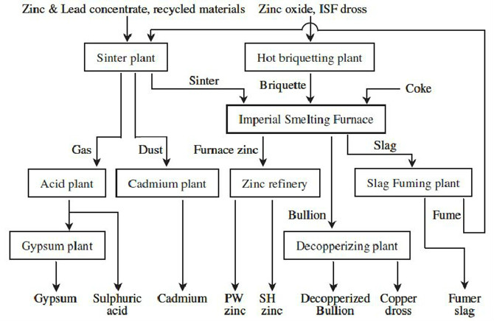

Slide 16
Process Flow Diagram
Utkarsh Tiwari

Slide 17
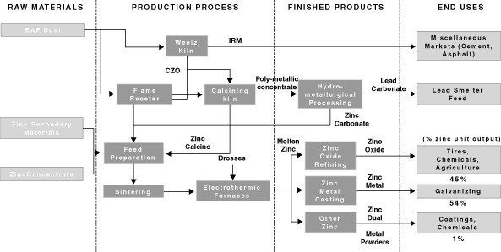
FLOW CHART OF HORSEHEAD HODLING CORP.

Slide 18
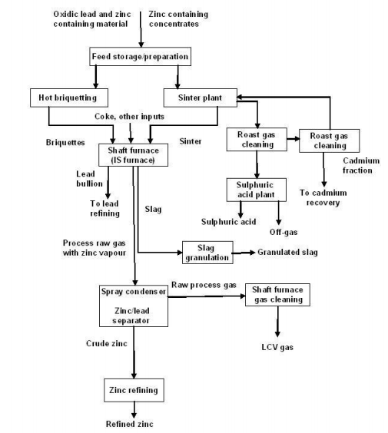
ZINC SMELTING IN IMPERIAL PERIOD

Slide 19
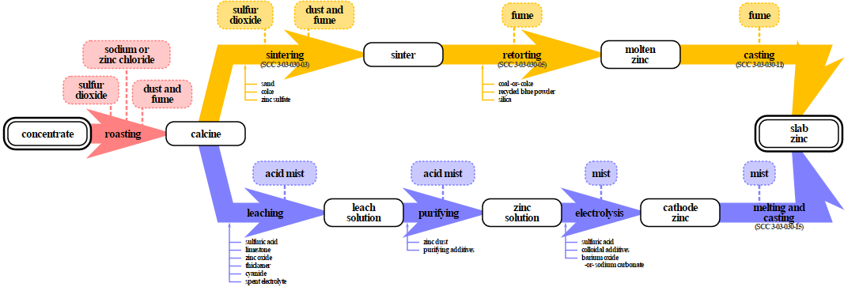
STANDARD ZINC SMELTING

Slide 20
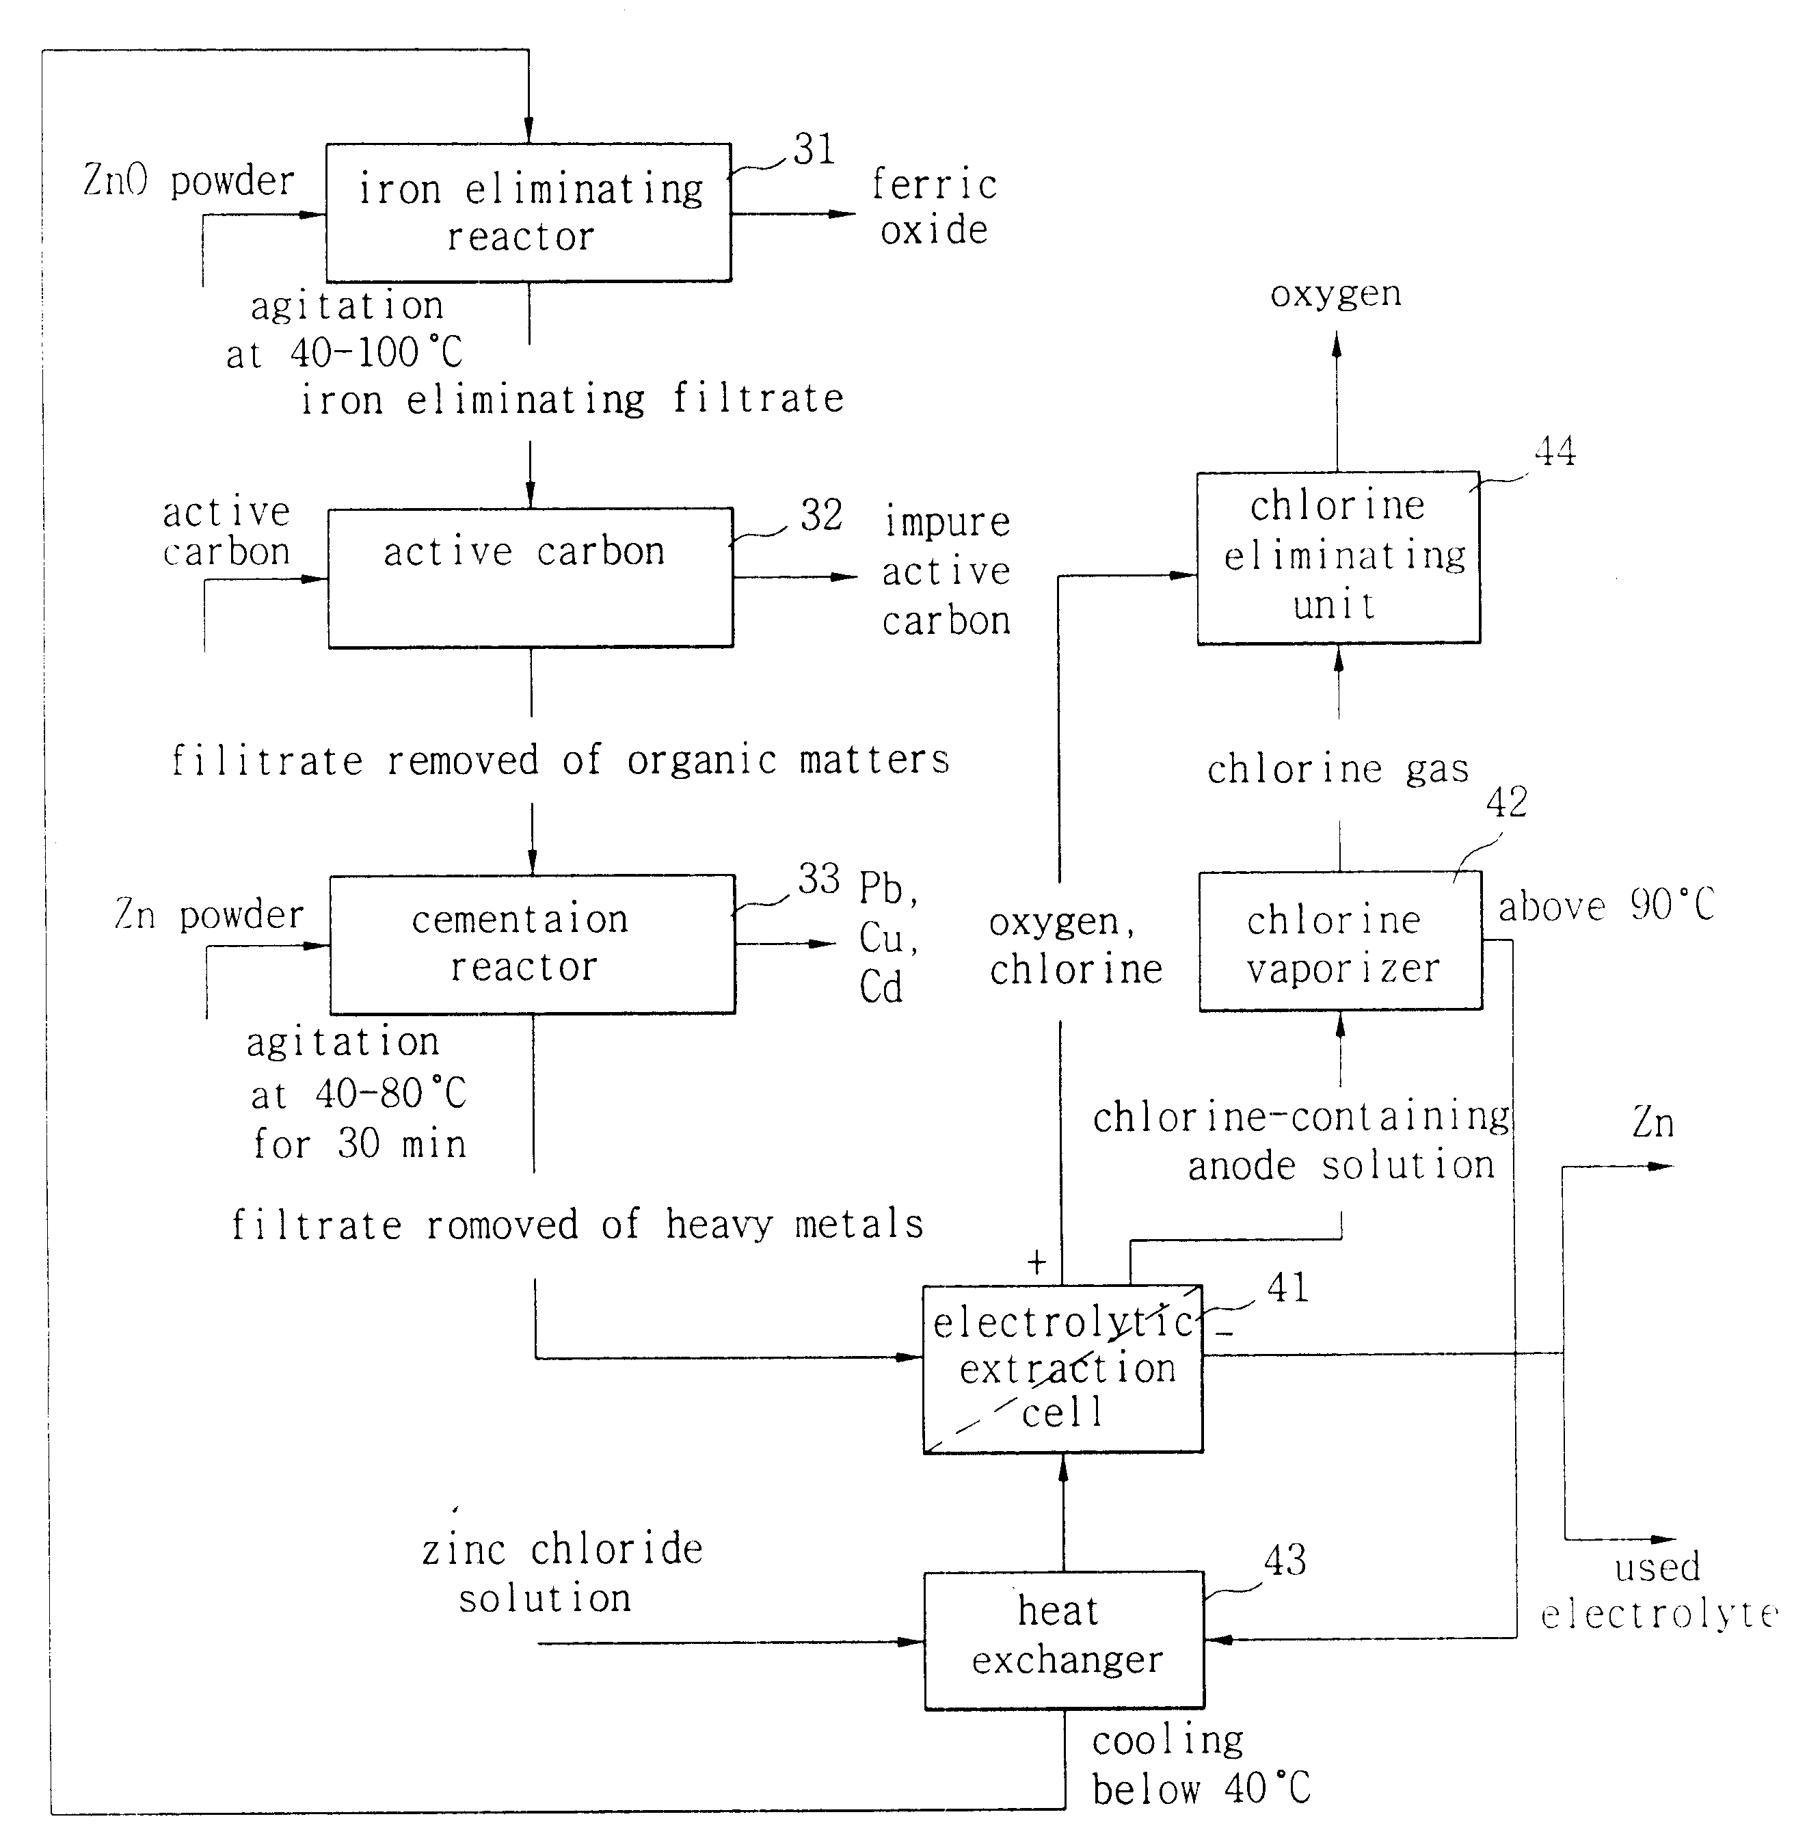
HYDROMETALLURGY PATENT US6338748

Slide 21
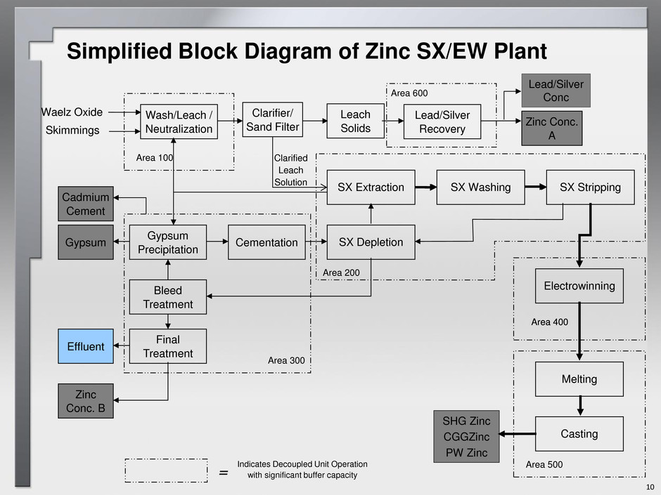
ZINC SOLVENT EXTRACTION AND ELECTROWINNING PROCESS

Slide 22
PFD for Electrolysis of ZnCl₂ (sparsely used)
Crude ZnO is leached with HCl
Purification with excess Cl₂
Evaporation with saturated steam
Crystallization with heat exchangers
Dehydration using Chlorine gas
Electrolysis of molten pure zinc chloride to release molten zinc at cathode

Slide 23
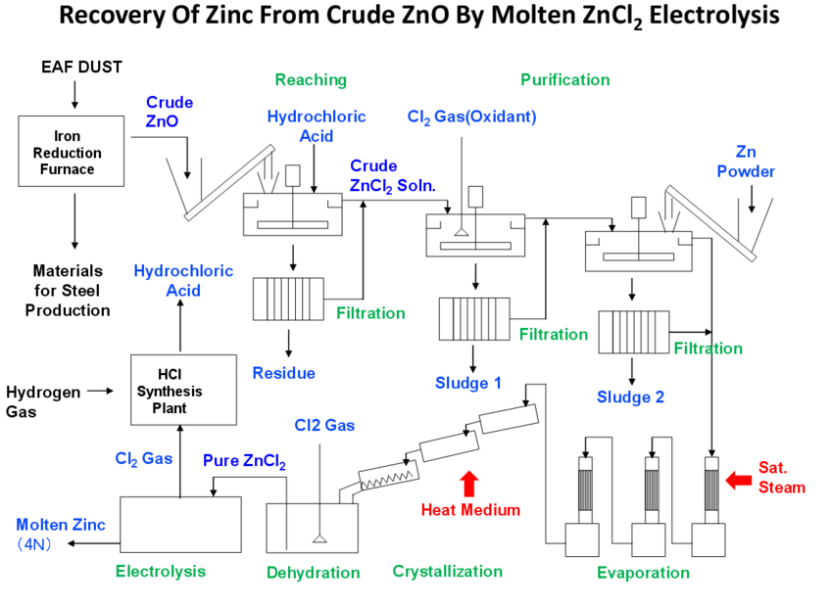

Slide 24
PFD for Electrolysis of ZnSO₄ (widely used)
Roasting of ZnS concentrate to ZnO
Reuse of SO₂ as sulphuric acid or leaching
Leaching of impure calcine to form impure ZnSO₄
Separation and recovery of impure metals
Purification of Zinc Sulphate
Electrolysis of ZnSO₄ to deposit Zinc on Aluminium Cathodes and release Oxygen

Slide 25
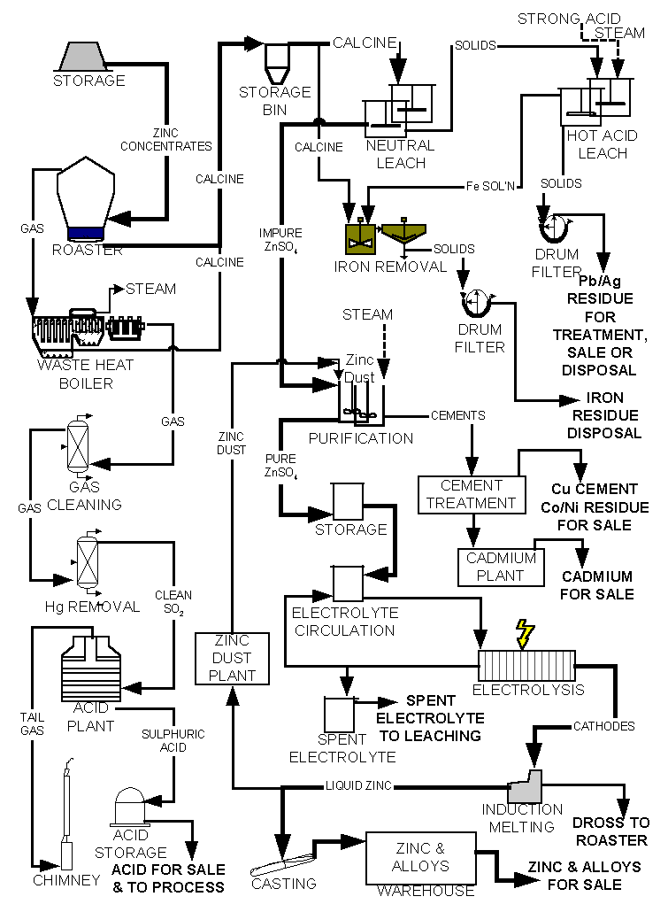

Slide 26
Recycling of Zinc
Scraps, skimmings and discarded products are recycled to recover zinc
Scrap is sweated to remove high melting impurities
Melting of scrap to extract zinc
Leaching of residue to get zinc oxide
Retort reduction to get zinc
Distillation of zinc to form alloys and ingots
The next three slides constitute a single flow sheet

Slide 27
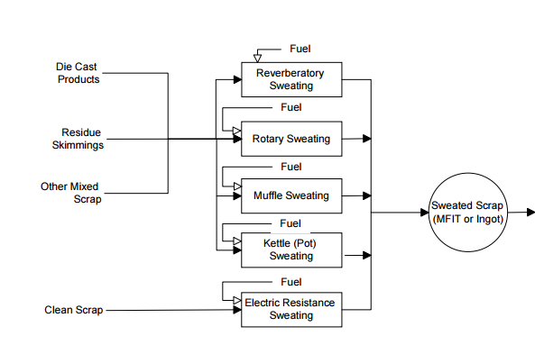
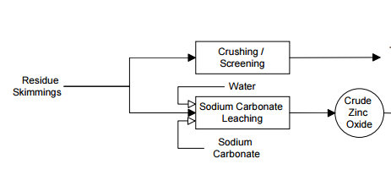

Slide 28
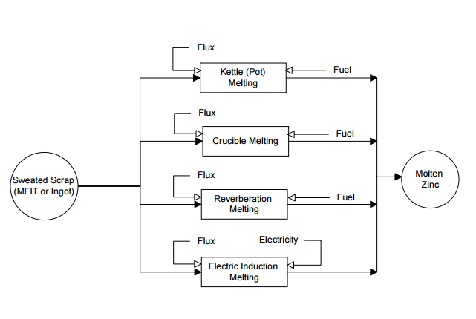

Slide 29
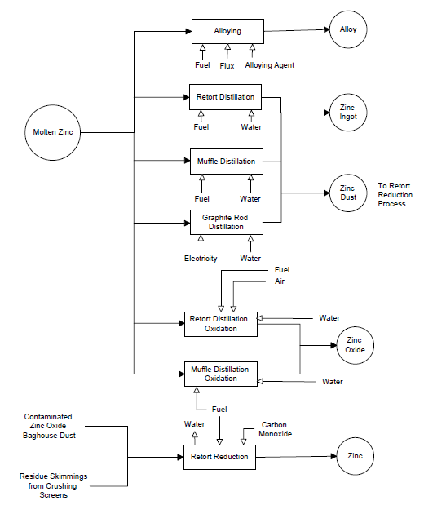

Slide 30
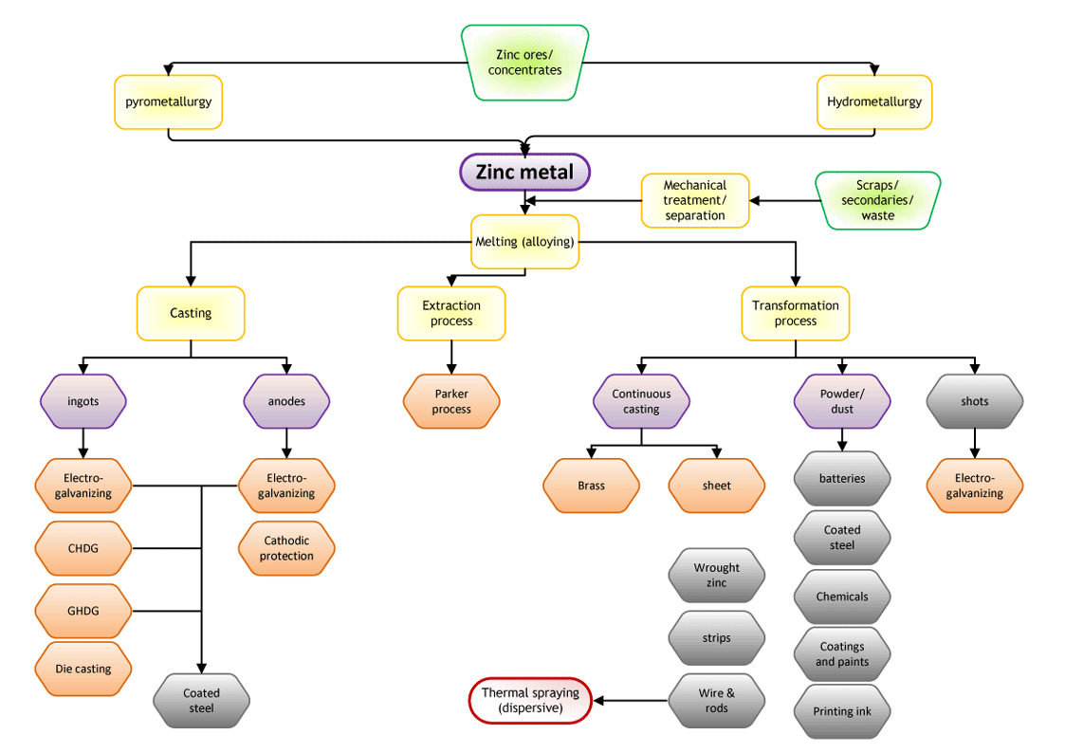
Flow chart of uses of Zinc

Slide 31
PROCESS COMPONENTS AND EQUIPMENTS
HITESH VARMA

Slide 32
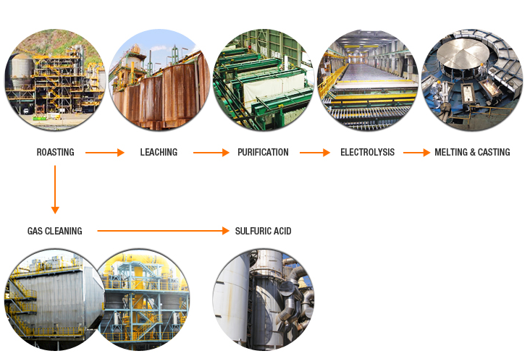

Slide 33
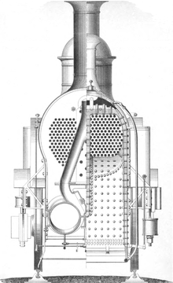
boiler
Steam boiler is basically a closed vessel into which water is heated until the water is converted into steam at required pressure.
Lotus Boilers And Pressure Vessels Pvt Ltd
Elite Thermal Engineers Private Limited

Slide 34
Distillation columns.
Used in the gas cleaning step.
Manufacturers
JD cousins and sons
Excel Manufacturers, Mumbai

Slide 35
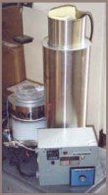
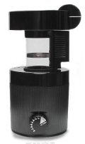
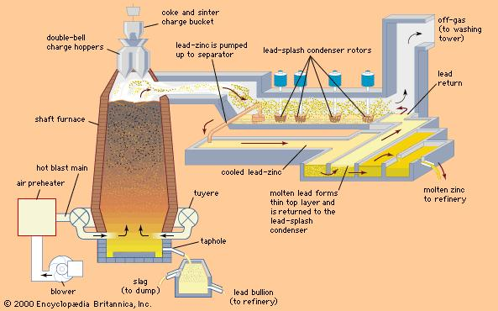
Roaster
Fluid bed roasters are used.
Unlike the drum roaster, the fluid bed roaster uses convection to deliver heat and has distinct roast characteristics.
Advantages- its ease of clean up, less time during roasting and have roast uniformity.

Slide 36
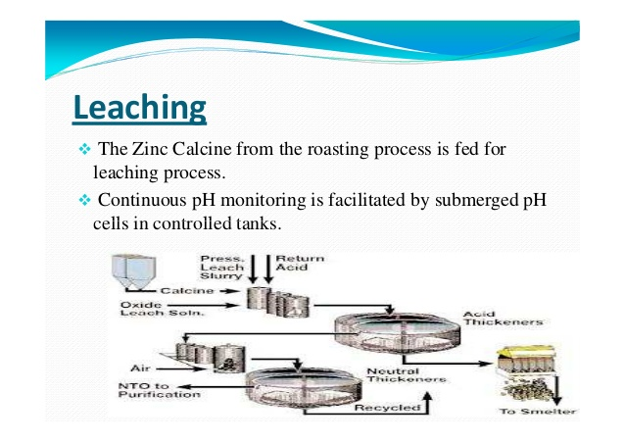
Hot acid Leach
The Zinc Calcine from the Roasting Process is fed into the agitated reactors which are controlled to varied pH by additions of Zinc Calcine, Electrolysis Acid.
Continuous pH monitoring is facilitated by submerged pH cells in controlled tanks.

Slide 37
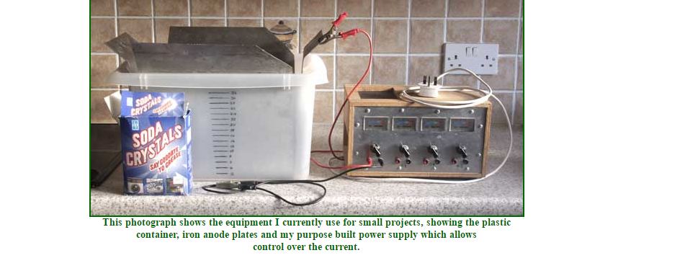
Electrolysis

Slide 38
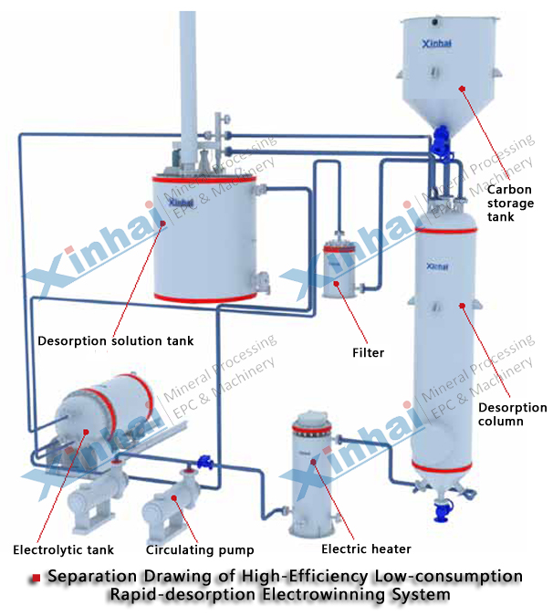

Slide 39
CONCLUSION AND FUTURE SCOPE
Jaipal S Rathore

Slide 40
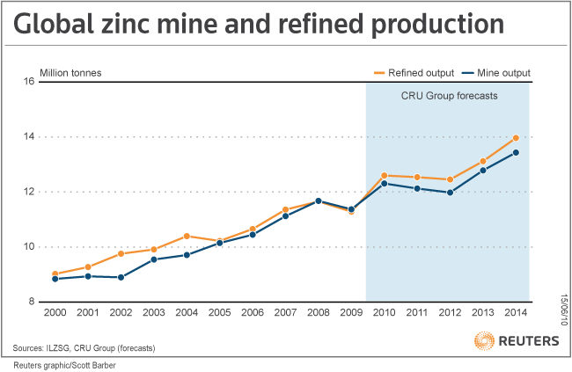
Because of the high market demands and growing environmental concerns the extraction of zinc from zinc oxide needs to optimize its electrolytic process.

Slide 41
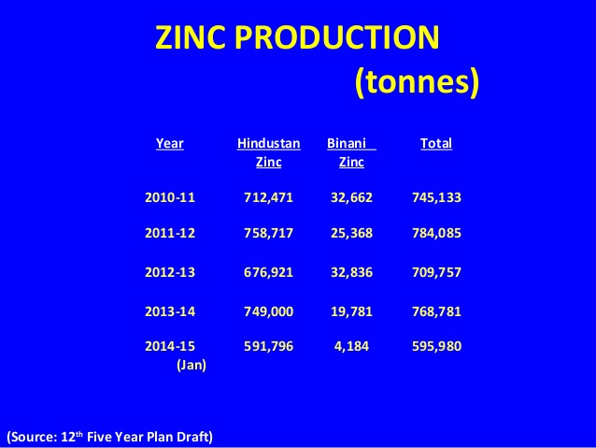
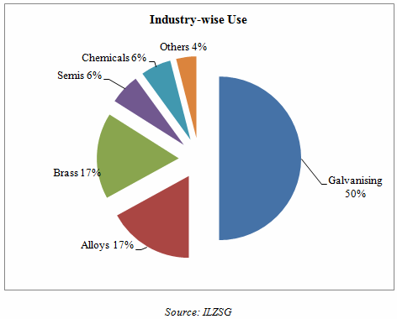

Slide 42
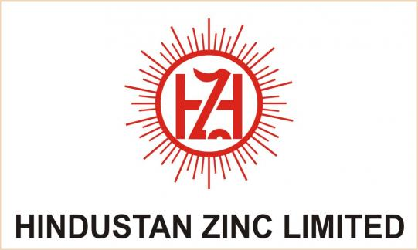
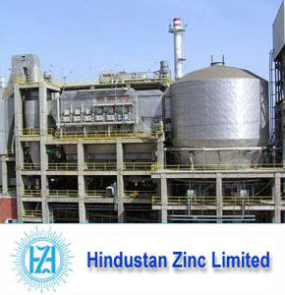
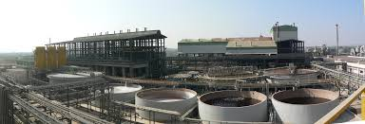
HINDUSTAN ZINC LIMITED
80-90% zinc is produced by Hindustan Zinc Limited in India

Slide 43
REFINING ECONOMICS
While considering the economic performance of a electrolytic process , several characteristics should be noted:
Feedstock costs (primarily zinc oxide )
Electricity costs and other operational costs for the electrolytic cell
Market prices for the products produced

Slide 44
EVALUATING ECONOMIC PERFORMANCE
Electrolysis process: alkaline leach with electrolysis & the conventional acid leach with electrolysis.
ZnCl₂ : high or low iron content
Depending on the quality investment costs differ.
Profitability
Environmental costs

Slide 45
Pollution
Air pollution
Water pollution
Wastes
Noises

Slide 46
Air pollution
Primary zinc processing generates air emissions during roasting.
Roasting is responsible for more than 90 percent of the potential SO2 emissions and cadmium vapor.

Slide 47
Water pollution
Wastewaters generated during the leaching, purification and electro winning stages of primary zinc processing when electrolyte and acid solutions become too contaminated to be reused again.

Slide 48
Wastes
Solid wastes, some of which are hazardous, are generated
Solid wastes include ferrosilicon, tower blow down, mineral residue, spent cloths, bags and filters, gypsum, impoundment solids, slag, and refractory brick.
Smelter slag and other residues of process also contain significant amounts of heavy metals

Slide 49
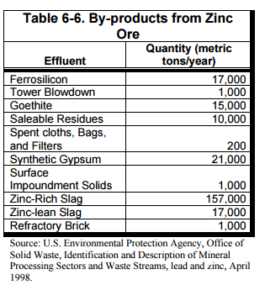

Slide 50
Future scope
Alkaline leach and electrolysis process for zinc production as an important alternative technology.
Placement of the cathode stripping used in the acid process, by automated dendrite removal.

Slide 51
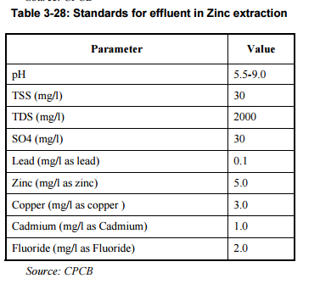
Pollution control board

Slide 52
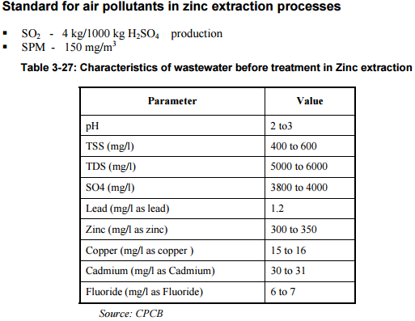

Slide 53
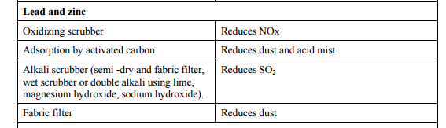

Slide 54
Thank you

